Slide 1

Sentiment Analysis on Movie Reviews with NLP and Creating a Recommendation System Amin KHOEINI
Data Science Career Track Capstone Project September 2021 Cohort

Slide 2
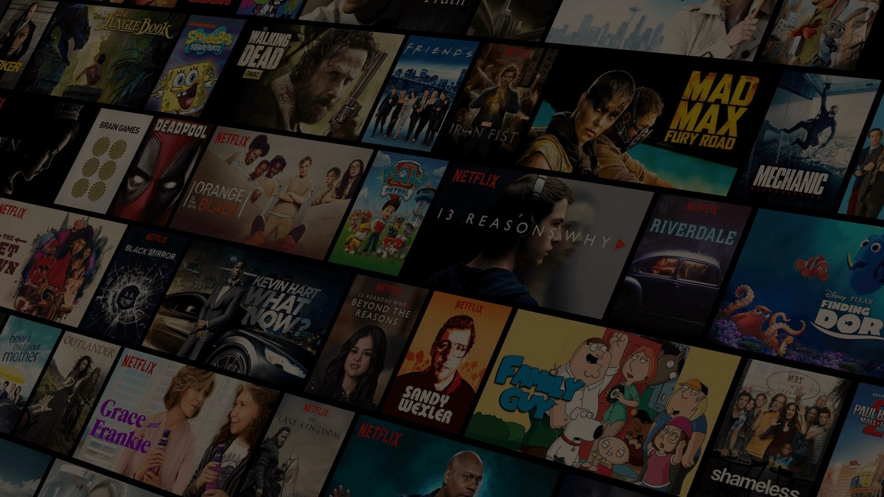
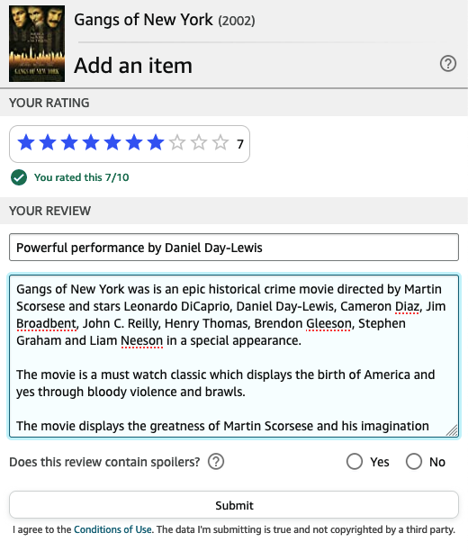
Problem:
Streaming site tries to make user to engage more with platform.
Recommending movie, more movie watch more time spends on the platform.
Netflix uses thumbs up and double thumbs up for this feature and then creates a list specific to the user’s liking to watch.
IMDB as biggest movie database can imply same same recommendation system.
This means that people have more clicks and spend more time on the website which further suggests more user engagement and ad revenues for IMDB.

Slide 3
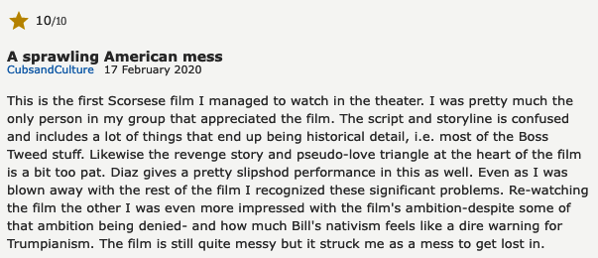
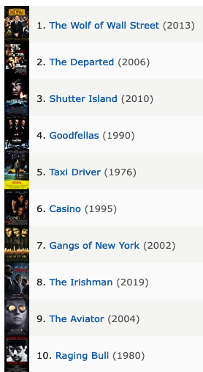
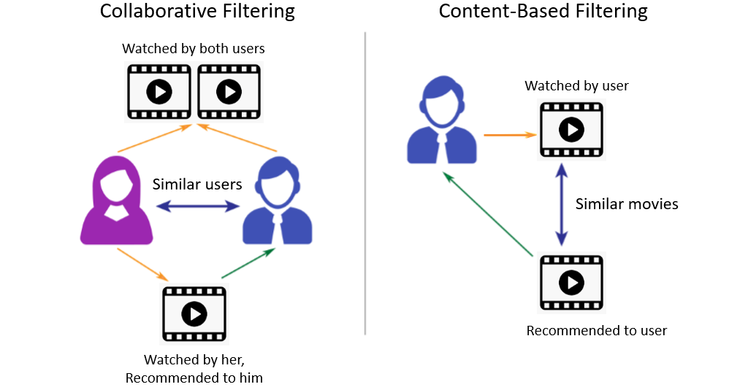
Goal and Utility:
Make a NLP model predict the sentiment of the user review. User Love the movie or not interested in it.
In the case that the user love the movie, create a recommendation list for user to watch and probably write more review on the website.

Slide 4
Data Wrangling:
Reviews
Movie Metadata
User ID : created from reviewer user name
Movie ID : extracted form the IMDB link
Review: processed, Lemmatize and Stem
Label: created from the rating
Love it and Not Love It
Movie ID
Movie Title
Year
Director
Genre
Actors
Description

Slide 5
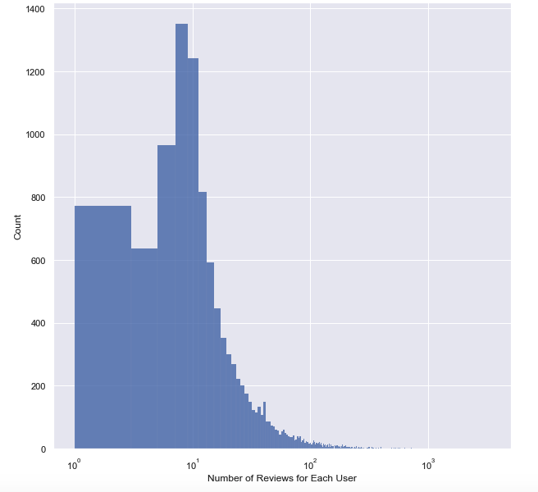
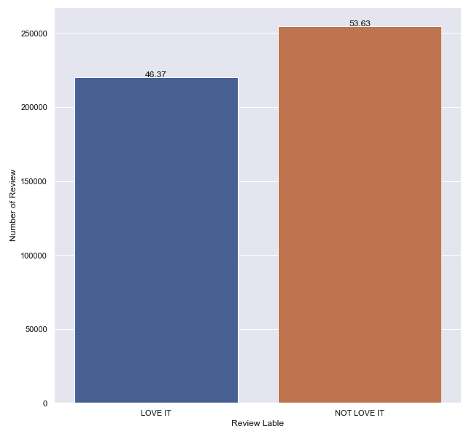
Data Exploration: Label
Most of the user wrote less than 10 review on the website
Good balanced distribution of label

Slide 6
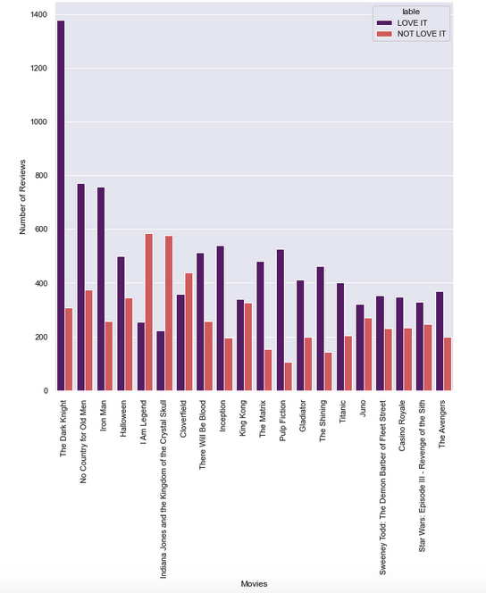
Data Exploration: Movies
Popular movies have considerably more positive reviews
there are a large number of negative reviews for I am Legend, Indiana Jones and the Kingdom of the Crystal Skull.
Indiana Jones was the reboot of the famous series which apparently viewers did not like.
Notes:
Popular movies have considerably more positive reviews, especially the top three movies. But at the same time, there are a large number of negative reviews for I am Legend, Indiana Jones and the Kingdom of the Crystal Skull, and Cloverfield. Indiana Jones was the reboot of the famous series which apparently viewers did not like. This is the case for most of the reboots for successful series’ in the past, as it has been seen for the Matrix series.

Slide 7
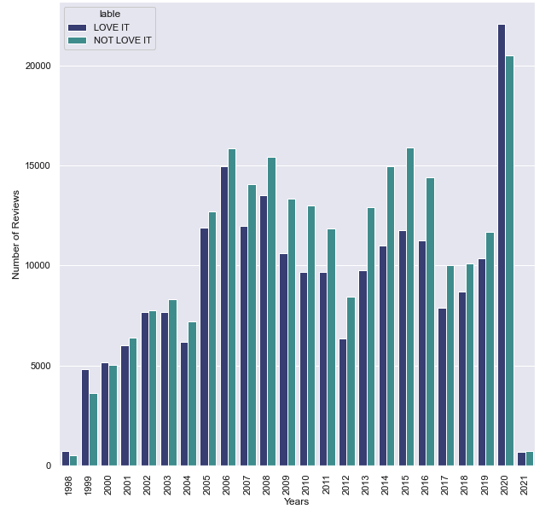
Data Exploration: Years
Jump in reviews in 2020
Also positive reviews are more than negative for first time
Notes:
In 2020, users of IMDB wrote the largest number of reviews. People were at home because of the pandemic and therefore, watched more movies on streaming services and wrote more reviews. Also, for the first time after IMDB was created, there were more positive reviews than negative. Most likely because a more regular audience was using IMDB and writing reviews in comparison to before when only cinephiles used to write reviews on IMDB.

Slide 8
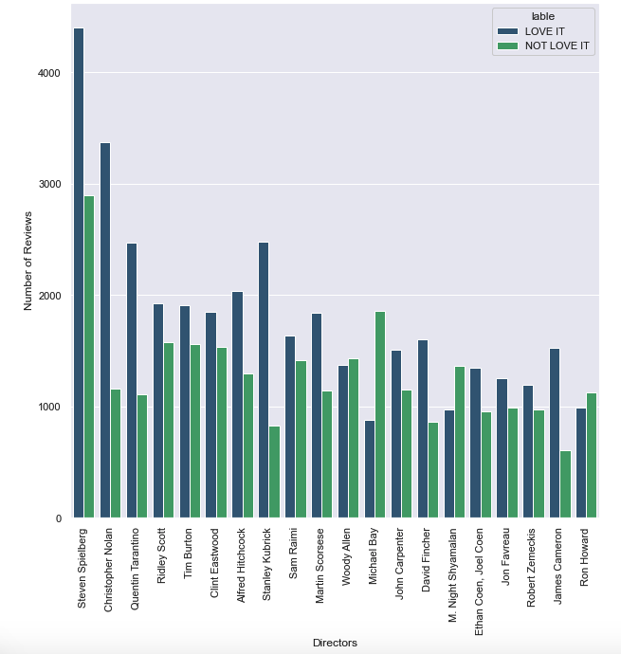
Data Exploration: Directors
Famous directors have the most reviews about them.
Michael Bay and M. Night Shyamalan are notorious for making a bad blockbuster.
Woody Allen also has more negative reviews
Notes:
Obviously, famous directors have the most reviews about them, but if we look at the distribution of the label, there is an interesting insight. Micheal Bay and M. Night Shyamalan are notorious for making a bad blockbuster and here it can be seen that they have more negative reviews. Besides this, Woody Allen also has more negative reviews than positive and this might be because of the drama that he faced in the media recently. The rest of the directors have more positive than negative reviews and this is expected because these are famous directors that received most of the reviews.

Slide 9


Review Sentiment analysis:
NLTK library
Tokenize the review corpus
Remove the stop word and punctuation
Lemmatized using WordNetLemmatizer
Stem using SnowballStemmer
Sklearn Library
TFIDF vectorizer
MultinomialNB, LogisticRegression and Linear SVC

Slide 10
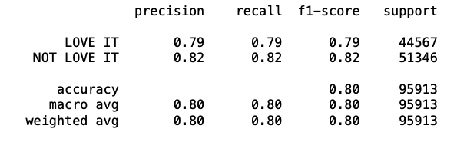
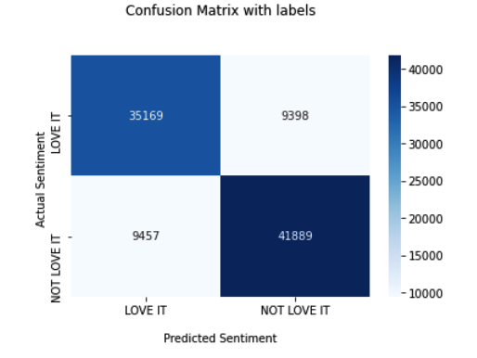
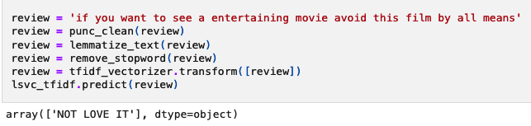
Review Sentiment analysis:
Liner SVC with hyper parameters ( C = 1, loss = hinge, penalty = l2)
Best performance with 81% accuracy

Slide 11
Recommendation system:
Content-based Filtering
Movie Metadata
Hybrid Recommendation
User (Reviewer)
Rating Dataset
Collaborative Filtering
Recommendation Movies

Slide 12
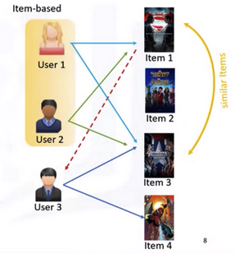
Content-base filter:
Using movie properties to make a item based filter
Create a mix of all the movie data columns
Called it soup
Do the Tfidf vectorization
Use cousin similarity to make a matrix
Create a list of 30 movies closest to the target.

Slide 13
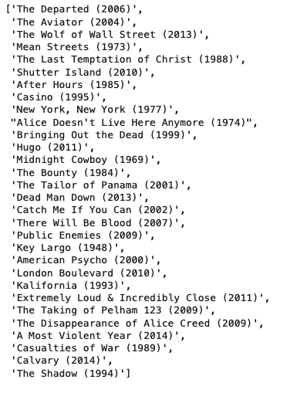
Content-base filter:
Gangs of New York
2002
Crime/Drama
Martin Scorsese
Leonardo DiCaprio

Slide 14
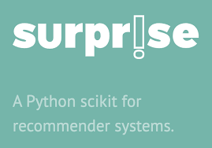
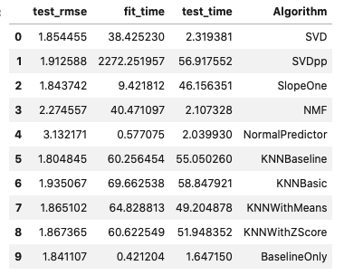
Collaborative Filtering:
Using the Surprise library
Rating Data (User ID, Movie ID, Rating)
KNNBaseline algorithms has the least RMSE

Slide 15
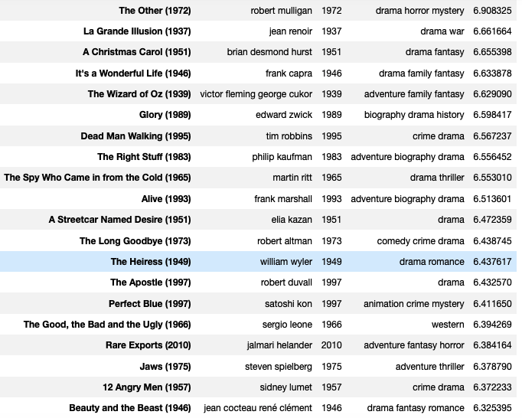
Collaborative Filtering:
Getting the top 20 movie based on the rating for user ID of 2.

Slide 16
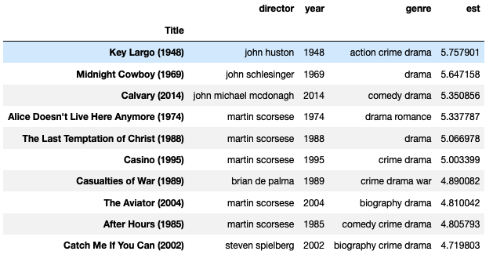
Hybrid recommendation:
First Used the content-base filter to get the 30 movie that closest to the target movie.
Use the collaborative filter to predict the rating for this list for the target user
Sort the list based on the predicted rating
Print the top 10 as the final recommendation

Slide 17
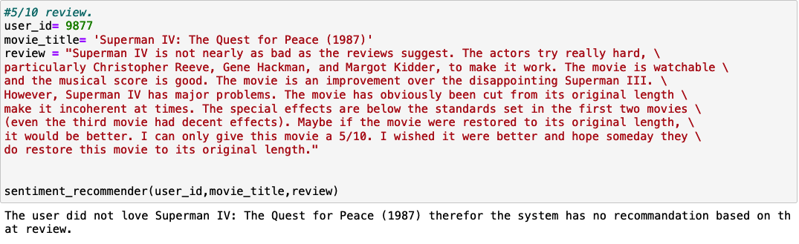
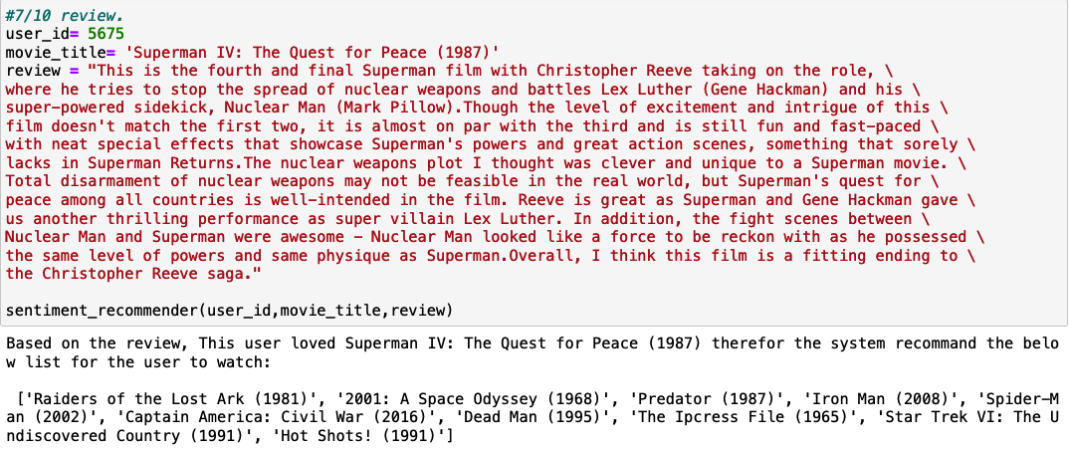
Modeling:
The final stage is to combine the NLP model with the Hybrid recommendation.
Input:
User ID
Movie Title
Review
Output:
In case of negative review, no recommendation
In case of positive review print the recommendation list

Slide 18
Future Improvements:
In NLP model and sentiment analysis, it is optimal to have an accuracy above 90%
Having more reviews, better hardware to run hyper parameters tuning for even more different algorithms, would help to improve the NLP performance.
There is only data about 4000 movies in the dataset. Because of that the recommendation engine was limited to those only.
Having more score and user data created more reliable recommendations for the user.

